Slide 1
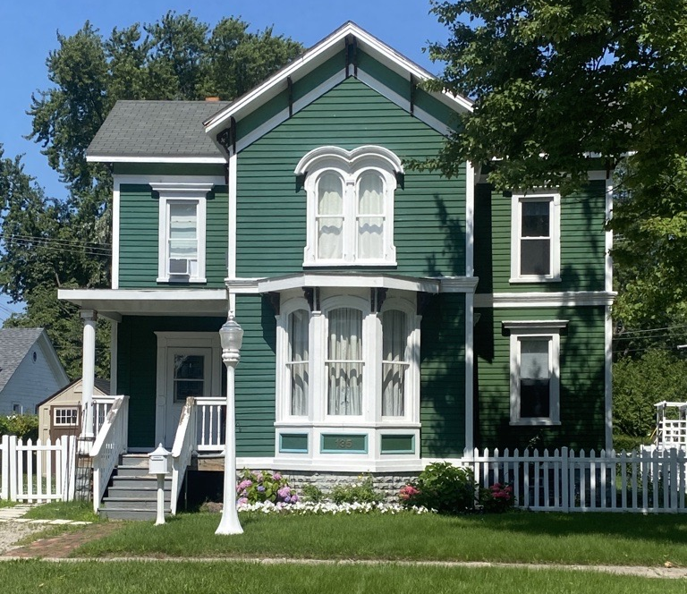
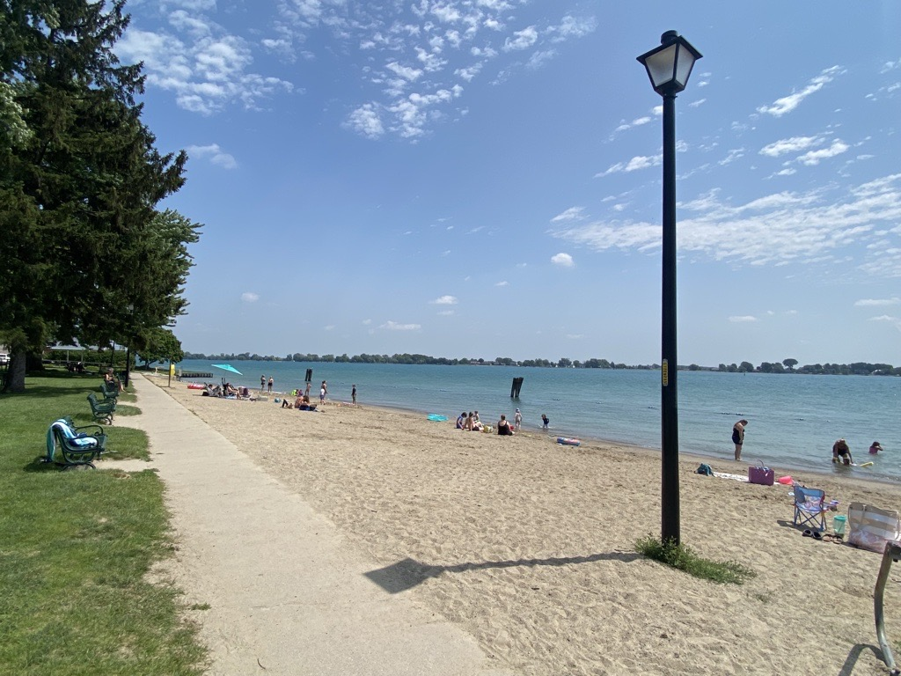
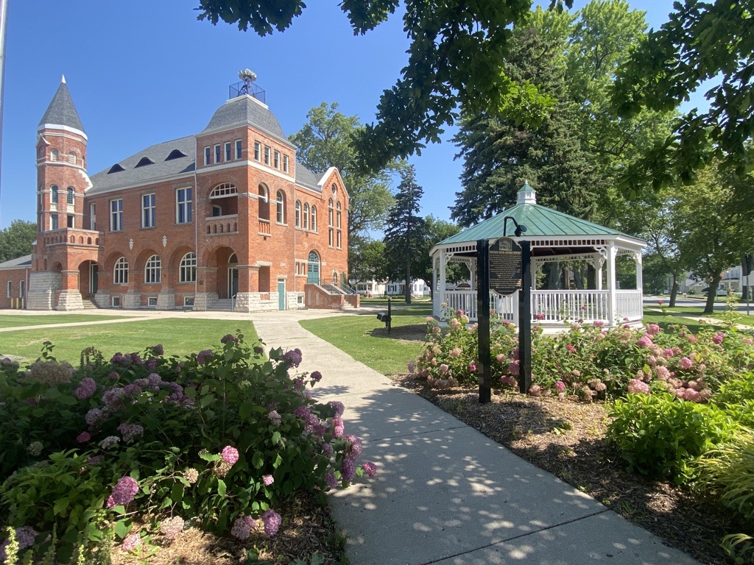
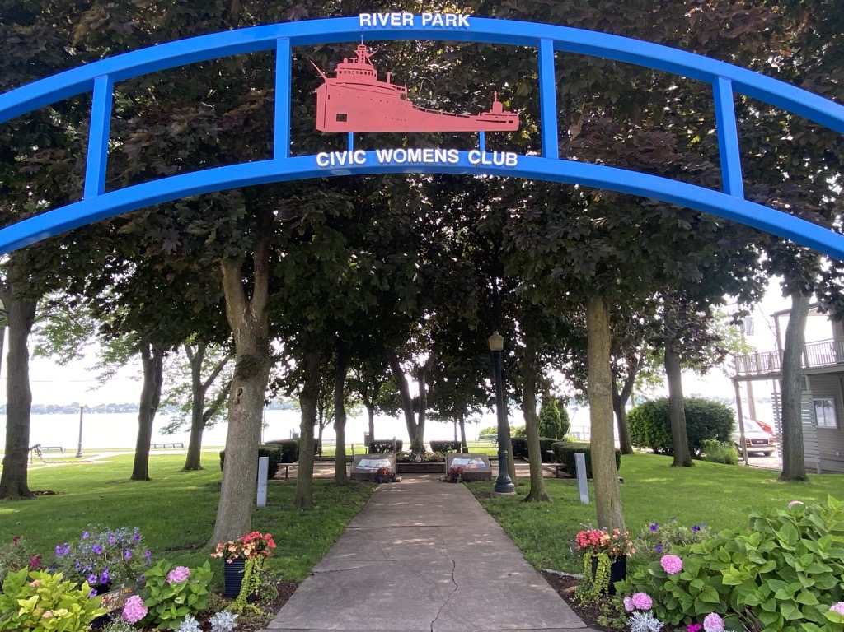
Master Plan
Update
1

Slide 2
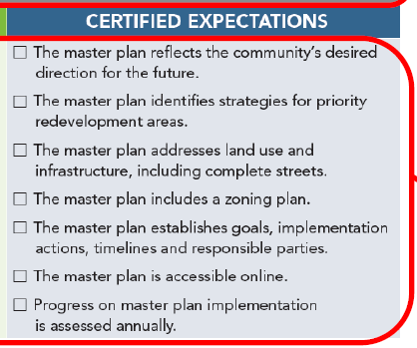

Redevelopment Ready (RRC)
Plan Updates
Zoning
Development Review
Boards & Commissions
Economic Development / Marketing
Redevelopment Ready Sites
Guides & Templates
Notes:
Essential RRC integrates best practices of predictability in development procedures into local processes. Taking it a step further and requiring additional reporting procedures, Certified RRC emphasizes proactive measures to attract development activity to a locality.
Elements as part of Modernization that RRC expects: Green infrastructure, implementation of master plan recommendations, additional housing, parking and placemaking provisions, additional user-friendly elements in ZO.
Additional guidelines and expectations for waterfront communities: - maintenance, - strategies obtaining / retaining property on the waterfront

Slide 3
Summary of Findings

Slide 4
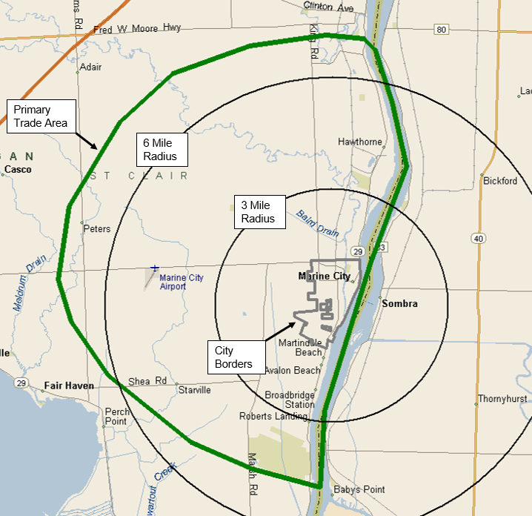
Retail Analysis
Primary Trade Area:
  extend north to the Pine Shores Golf Course,
  east to the St. Clair River,
  south to Algonac State Park and Swartout Road,
  and west to between Palms Road and Hessen Road.
  McKenna estimates that residents, visitors and workers inside the primary trade area will account for up to 60 to 70 percent of the total sales captured by retailers in Marine City.
Population and Consumer Market expected to decrease
Notes:
As part of updating Marine City’s master plan, McKenna is undertaking a redevelopment and economic development analysis that aims (among other things) to attract commercial development while maintaining a thriving business district. To help achieve that goal, we have conducted a retail feasibility analysis to determine how much and what types of retail and restaurants (if any) are currently supportable in the City.

Slide 5
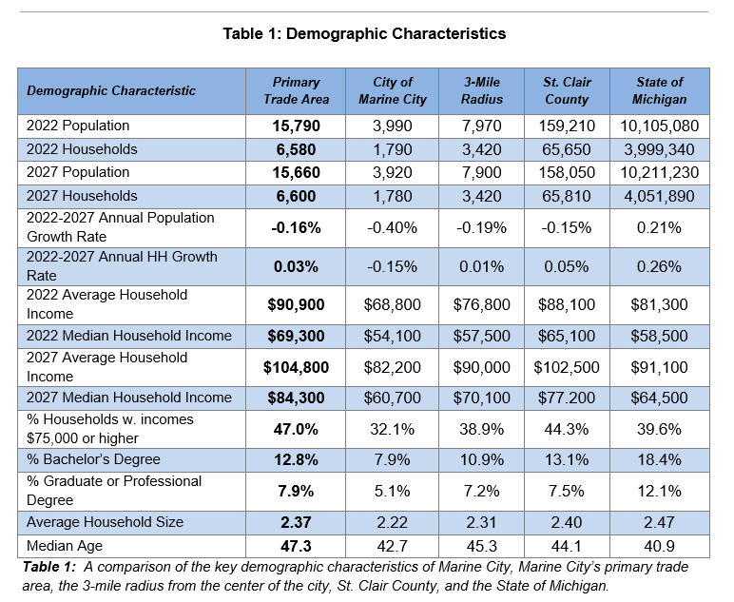
Retail Market Analysis
Table 2: The leading supportable retail and restaurant categories are grocery, hardware, full-service restaurants, and department store goods.
Notes:
Currently, the primary trade area has 6,580 households, which is projected to increase at an annual rate of 0.03 percent to 6,600 by 2027. The 2022 average household income is $90,900 and is estimated to increase to $104,800 by 2027
In comparison, Marine City reports a current average household income of $68,800 and median household income of $54,100. By 2027, the average household income is projected to rise to $82,200, with the median household income also rising to $60,700. Population and household counts are expected to slightly decrease, with annual growth rates through 2027 of -0.40 percent and -0.15 percent, respectively

Slide 6
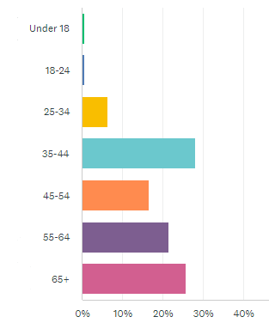
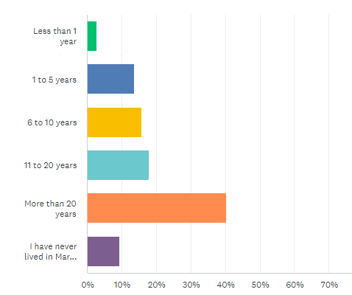
Key Takeaway from Online Survey
Who took the survey:
Residency Length
Age
Residents,
  Or Visitors of Parks and Businesses,
Own their own home,
Live in Single Family Homes
Notes:
Community beautification - public art, updated signage, vibrant community events
Code enforcement; blight, cars blocking sidewalks, dogs not on a leash etc.
Roadway improvements: roads, safety, pedestrian use, and more frequent buses up and down M29
More activities for kids

Slide 7
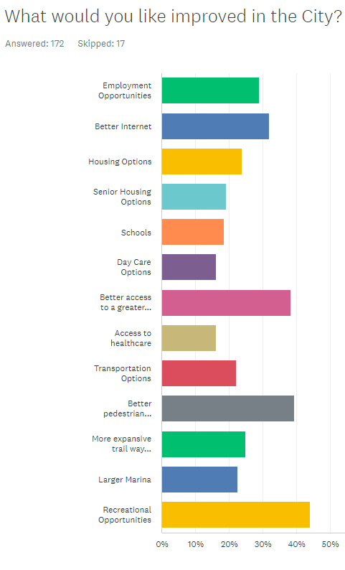
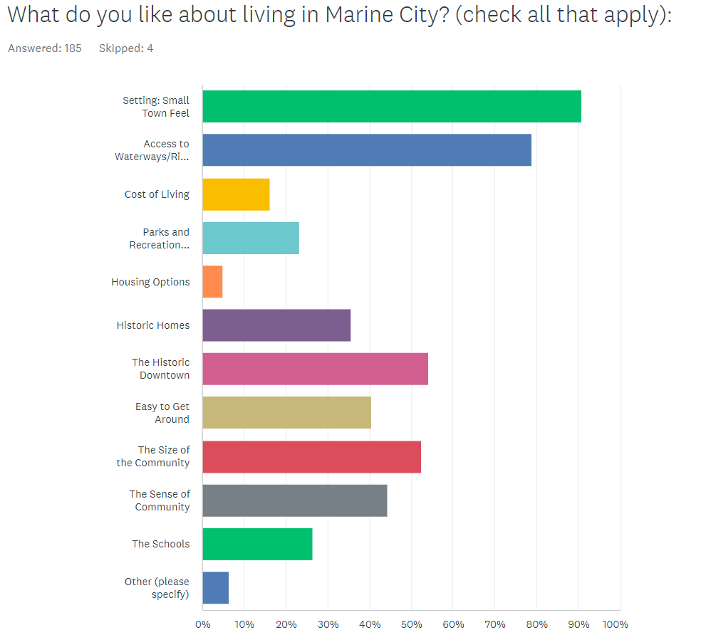
Key Takeaway from Online Survey
Improvements
Notes:
Housing people feel there is the right amount for SF, spread on Multi-family (not enough, don’t know, and enough), too much rental, need more owner occupied, …. They want more SF, but also senior living, and mixed use, condos (owner-occupied), duplex,
Recreational opportunities: overwhelming not enough
Renewable energy not enough and too much, Industrial (right amount to too much)

Slide 8
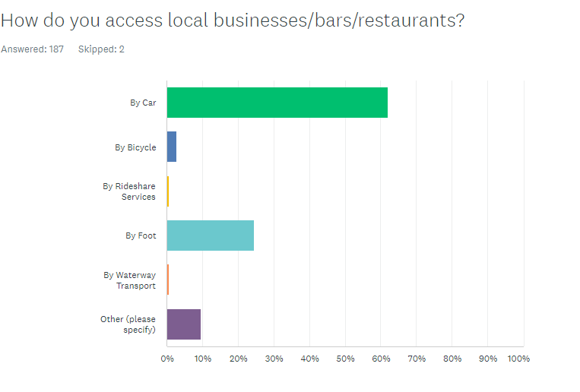
Survey Summary
Public Comment: “Nice to walk or ride bikes but sidewalks are junk”
Marine City is walkable in scale
Future planning efforts must identify and address the barriers and specific locations (cross walks, sidewalks in poor condition, too narrow sidewalks) that prevent residents from to walking to businesses
Notes:
Marine City is walkable in scale, we need to identify and address the barriers to people walking in p

Slide 9
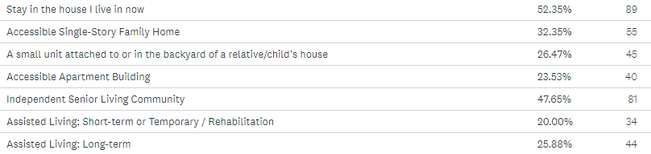
Survey Summary
Senior Housing Types
Notes:
Live near amenities (grocery etc)
Live near family and friends
- lack of activities, sidewalk and parking lot tripping hazard, have to drive to get everywhere
- senior living that allows pets

Slide 10
Summary of Recommendations

Slide 11
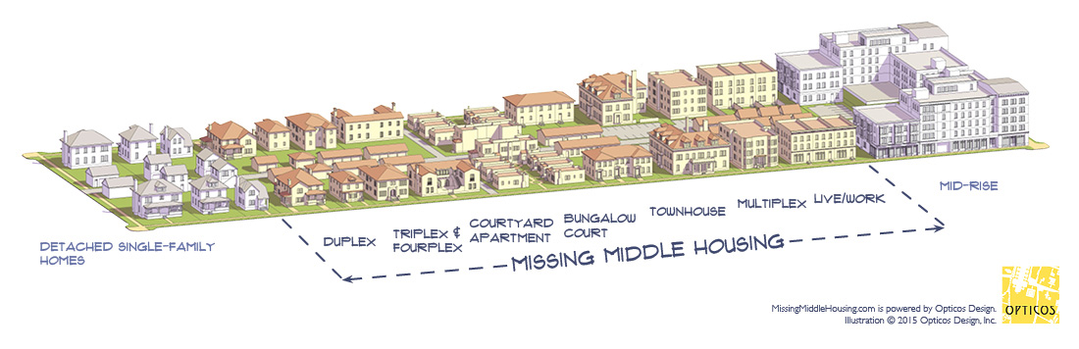
Open House Summary: Economic Development
October 10, 2023 at City Hall
Attract and Retain
  Unique features: double riverfront, lighthouse, 1800s old City Hall, riverfront parks with shaded seating and landscaping, freighter watching, Victorian-era homes
  Greening Improvements: Aesthetic improvements, pollinator program, prevent runoff
  Housing: New Residents and Seniors
  Multi-generational Recreational Activities
  Keep spending within the town with retail variety
Notes:
Housing: Cottage Courts, Condos (1 story), split level duplexes,

Slide 12
Open House Summary: Economic Development
Connectivity and Access
  Points that cut off multi-modal roadway access: Broadway Bridge, pedestrian crossings on Broadway
  Regional Transportation: Link Towns in St. Clair County
  Expand trailway system, connect to downtown
Branding and Marketing (new website, show lots for redevelopment, etc)
Parking
  Parking in the wrong places
  Accommodate deliveries for businesses along Water Street
Build Operational Capacity
  Recreational Manager
  CEDAM Economic Development Fellow
Notes:
Housing: Cottage Courts, Condos (1 story), split level duplexes,

Slide 13
Recommendations from the Open House
Marketing
Regional Collaboration to promote
Redevelopment
Brownfield Redevelopment
Streetscape improvements
Expand Walkable Downtown beyond Water St.
Connect Marina to Downtown
Support Downtown
Revolving Loan Fund
Regional Marketing Effort

Slide 14

Additional Recommendations
Design Standards
  Improve site design standards of non-downtown commercial district
  Commercial Downtown Overlay District (Broadway & Water St)
Establish a DDA (Downtown Development District)
  Expand the Downtown
  Monitor Design Standards, Maintain Character, Contribute to Infrastructure Improvements
Notes:
Housing retrofits, revolving loans?
The DDA district has the opportunity to expand upon its historic building fabric and improve upon the pedestrian experience through placemaking.

Slide 15
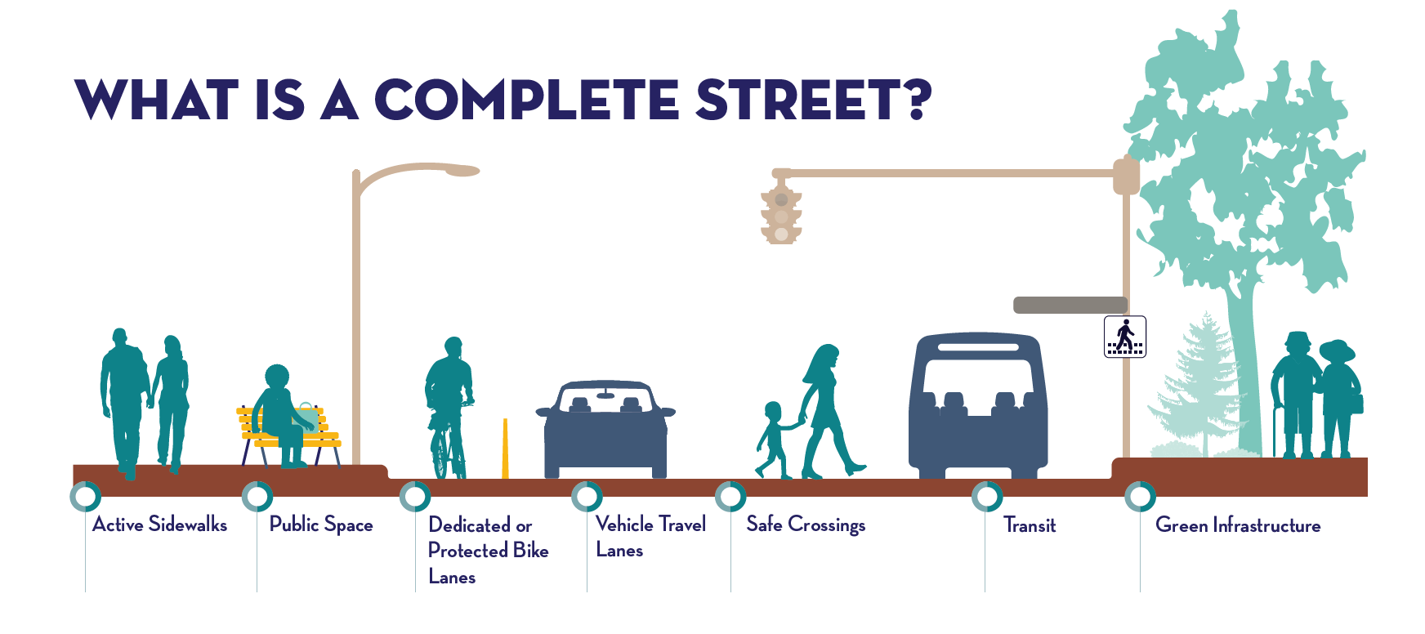
Greater Connectivity and Complete Streets
15
Notes:
Connect people to business, connect people to place. Expand on the Bridge to Bay Trail to the Downtown, make the trail more useful and exciting. Hear that the trail is boring, one simple step would be adding trees along the trail (shaded) etc. And connecting the trailway throughout the city, encourages greater trail usage beyond recreation / leisure purposes. Alleviate stress on parking
Streets Add Value. Eastpointe’s streets will enhance property value and be coordinated with land use development standards to support commerce through connectivity, design aesthetics, street life, and access. It’s important to note that studies show pedestrian and cyclists are more likely to spend greater amounts of money locally than private vehicle drivers.
* Protect Vulnerable Users

Slide 16
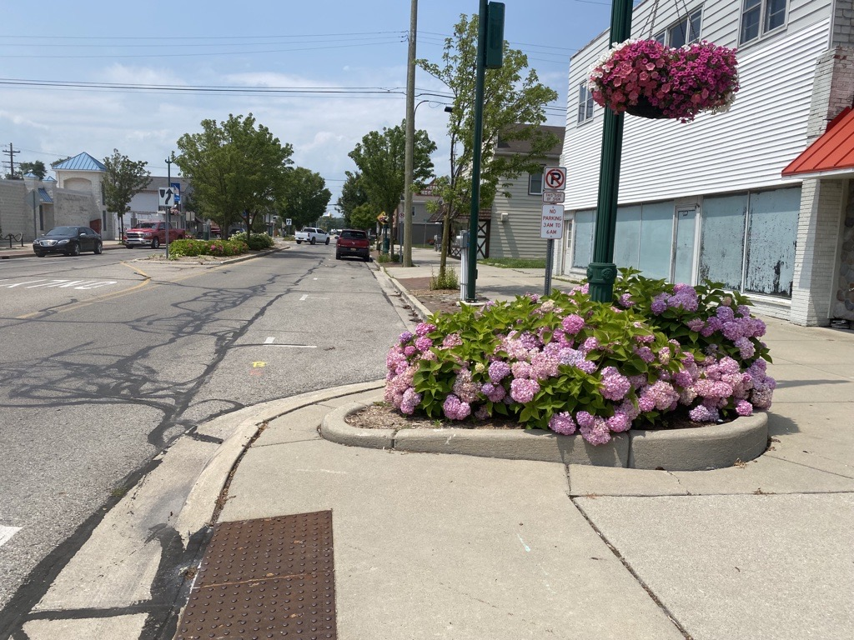
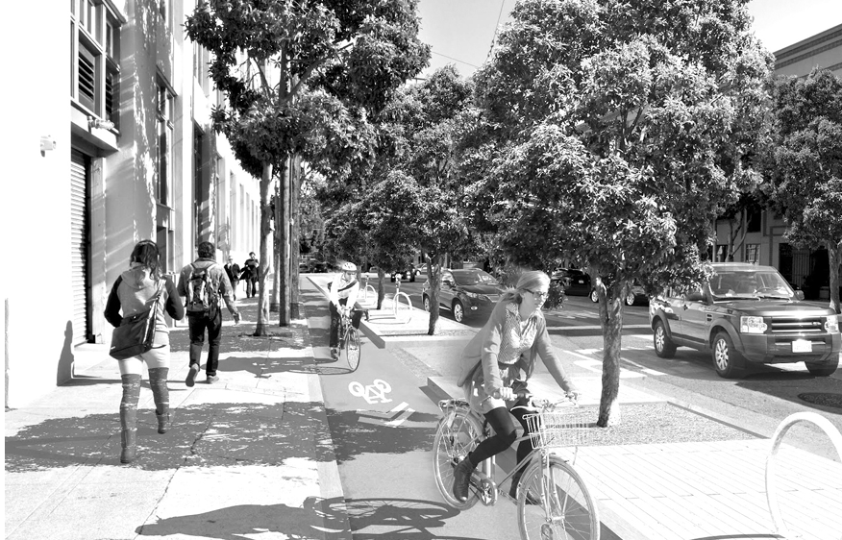
Greater Connectivity and Complete Streets
16
Marine City today
Example of a complete street
Notes:
Connect people to business, connect people to place. Alleviate stress on parking
Streets Add Value. Eastpointe’s streets will enhance property value and be coordinated with land use development standards to support commerce through connectivity, design aesthetics, street life, and access. It’s important to note that studies show pedestrian and cyclists are more likely to spend greater amounts of money locally than private vehicle drivers.
* Protect Vulnerable Users

Slide 17
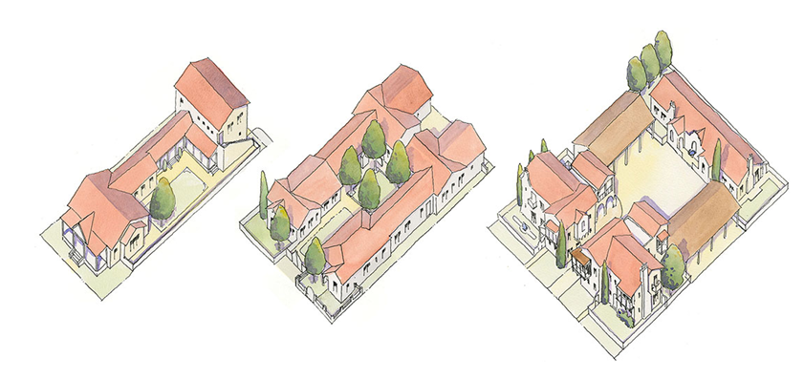
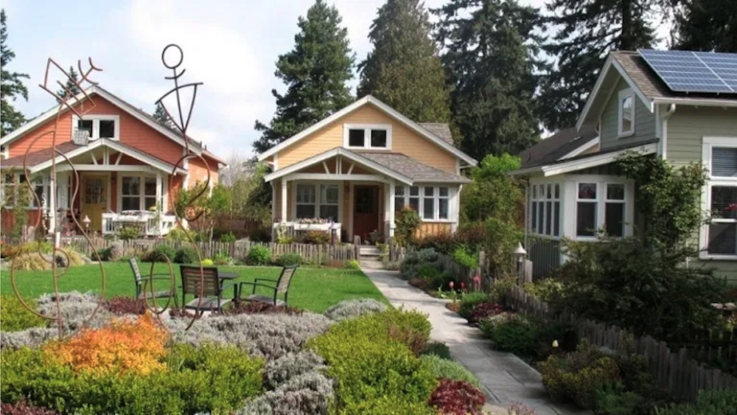
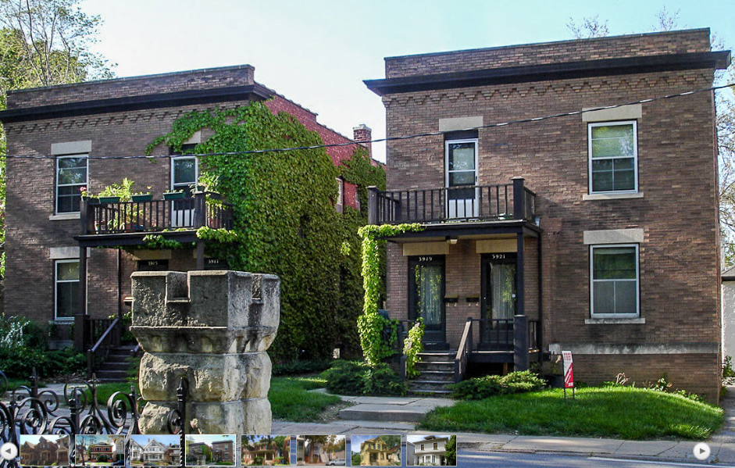
Housing!
Cottage Courtyard Example
Split-Level Duplex example
Notes:
Discussed allowing cottage courts and split level duplex

Slide 18
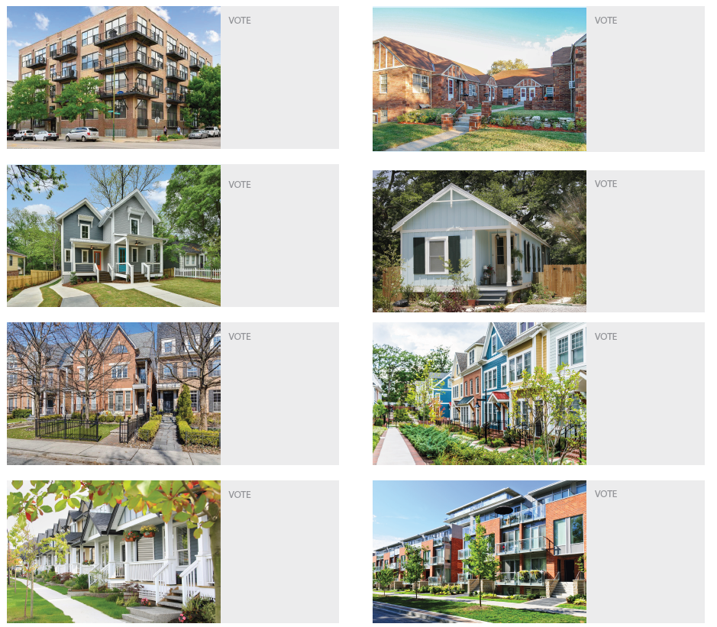
Group
Activity

Slide 19
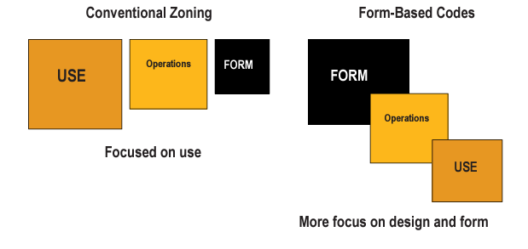
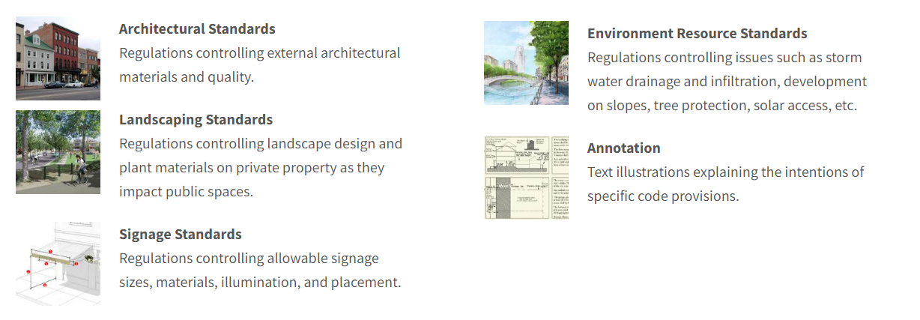
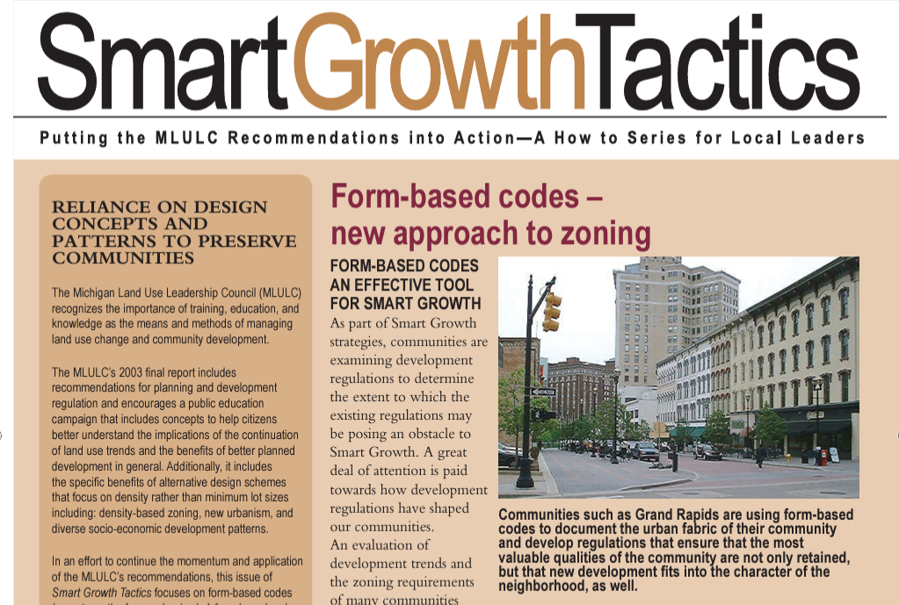
Form-Based Code
Notes:
set definite goals for the future to help direct redevelopment, protect the character of the community, and provide guidelines for new residential and commercial development in the Downtown. To ensure these goals were met, McKenna Associates worked with the City to develop a clear, concise, and graphic definition for the Downtown form using form-based code techniques and visual imaging.
City of Grosse Pointe, Holland, Saugatuck ? Farmington Downtown, Beverly Hills, MI

Slide 20
Notes:
set definite goals for the future to help direct redevelopment, protect the character of the community, and provide guidelines for new residential and commercial development in the Downtown. To ensure these goals were met, McKenna Associates worked with the City to develop a clear, concise, and graphic definition for the Downtown form using form-based code techniques and visual imaging.
City of Grosse Pointe, Holland, Saugatuck ? Farmington Downtown, Beverly Hills, MI

Slide 21
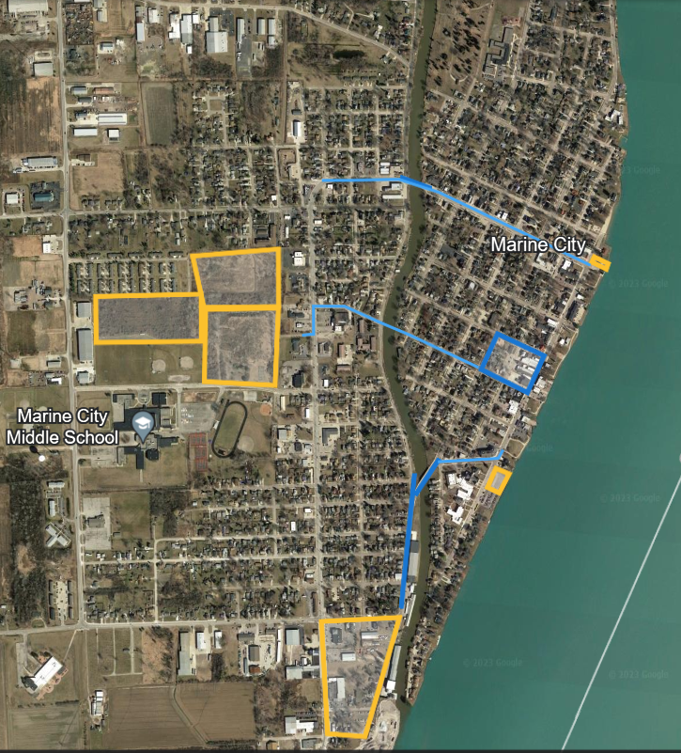
Redevelopment Sites
Yellow = Property Redevelopment
Blue = Streetscape Redevelopment
Notes:
https://earth.google.com/web/@42.71676951,-82.49999857,177.27236281a,4217.09485613d,35y,0.25635272h,0t,0r/data=MikKJwolCiExQkg0VVFoV25CYmV3MGZoZ1hjczQzVHFuSjdVbXprWkcgAToDCgEw

Slide 22
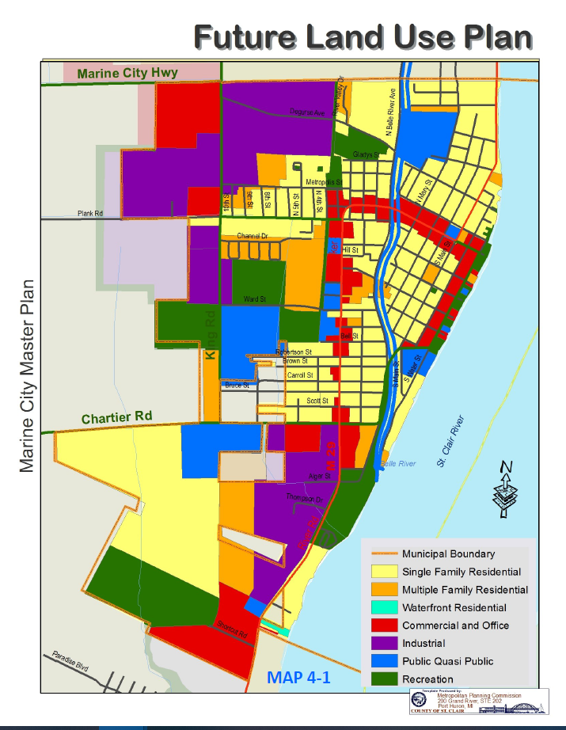
Future Land Use
Residential:
  Low and Medium Density Residential
  Create Waterfront Residential, any current residential along St Clair
  Recreational Spaces
  Industrial

Slide 23
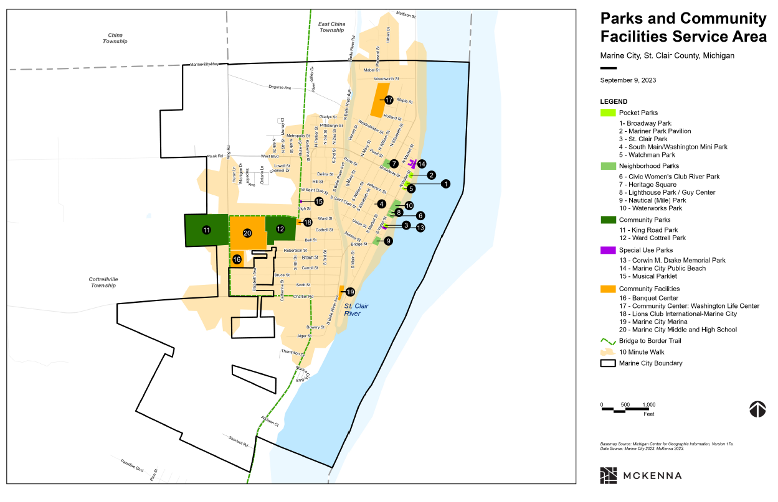
Areas Without Walking Access to Parks, Green Spaces

